Slide 1
CIS117 Week 11
Scripts with conditionals

Slide 2
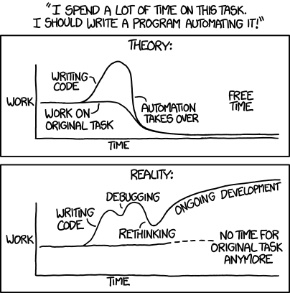
Basic if – then - else
Conditionals mean you have choices in a path
Not the same a loop
if [condition]
then
echo yes
else
echo "no"
fi
https://xkcd.com/1319/

Slide 3
explanations
if [ $answer = “Y” ] Brackets do test (can also use function test)
then Must include “then”
echo “Yes” If condition is true (can be multiple statements)
else
echo “No” If condition is false (can be multiple statements)
fi End of conditional (if backwards)

Slide 4
String testing
Tests for string comparison
=
Test for numbers (-eq –le –ge –gt –lt )
File test operators (with a few examples more in book/online)
-e if file exists
-s file is directory

Slide 5
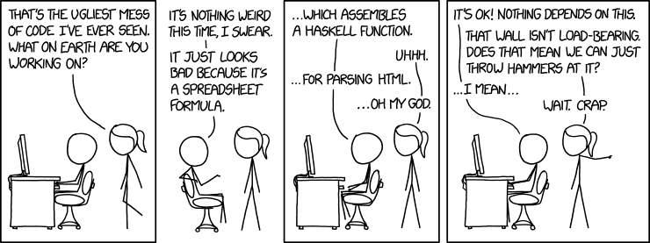
Debugging and common mistakes
Space matters (there and not there, can be picky)
Make sure the condition is right type (-eq vs = vs –f)
Watch for closing fi
https://www.explainxkcd.com/wiki/index.php/1926:_Bad_Code

